Slide 1
Deploy python web application in aws cloud

Slide 2
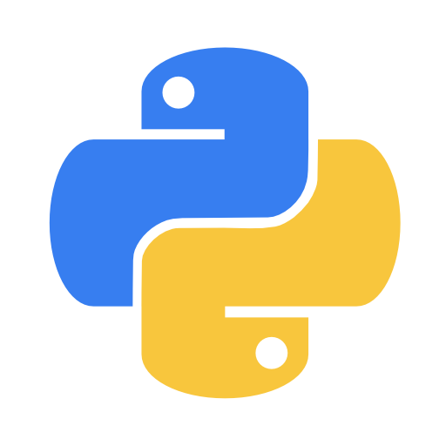
TOPICS :
WHAT IS PYTHON ?
WHAT IS FLASK ?
WHAT IS PIP ?
PRE-REQUISITE
SERVICES
PROCEDURE
EXECUTION

Slide 3
What is Python ?
python is a computer programming languages often used to build websites and software automates tasks and conduct data analysis.

Slide 4
What is flask ?
flask is a small and light weight python web framework that provides useful tools and features that make creating web application in python easier
it gives developers flexibility and more accessible framework for new developers since you can build a web application quality using only a single python file.

Slide 5
What is pip?
PIP → Package Installer For Python/
pip is a package manager for python package or modules if you like.
if you have python version 3.4 or later pip is included by default.

Slide 6
Pre-requisites:
AWS Account
EC2 Instance
VPC
GitHub
Git Bash
Basic understand on python and flask
Jenkins

Slide 7
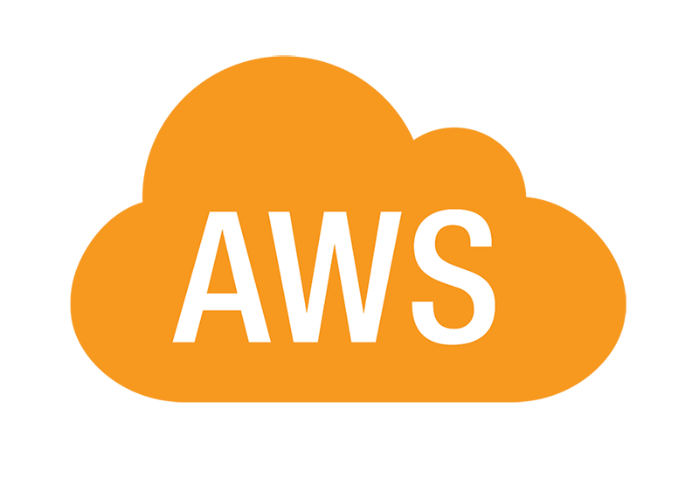
AWS services :
IAM
EC2
VPC

Slide 8
Procedure :
Create EC2 instance with default Vpc address.
install required packages and tools related for deployment of the project.
clone the project of source code form git hub to you local machine.
Then go to Directory of git cloned.
Now install requirement.txt
configure the python file(app.py)
Run the browser with instance Ip address with port number

Slide 9
Commands :
Sudo apt update –y
sudo apt-get full-upgrade –y
Sudo apt install python3-pip
git clone https://github.com/satishyekula548/Abalone-Age-Prediction-python.git
cd Abalone-Age- Prediction-python
pip3 install –r requirements.txt
sudo vi app.py
screen –m –d python3 app.py

Slide 10
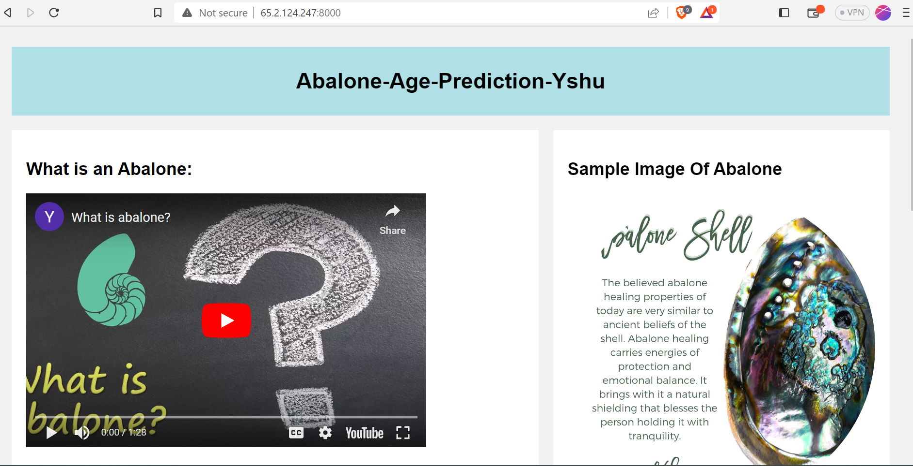
Execution :

